Slide 1

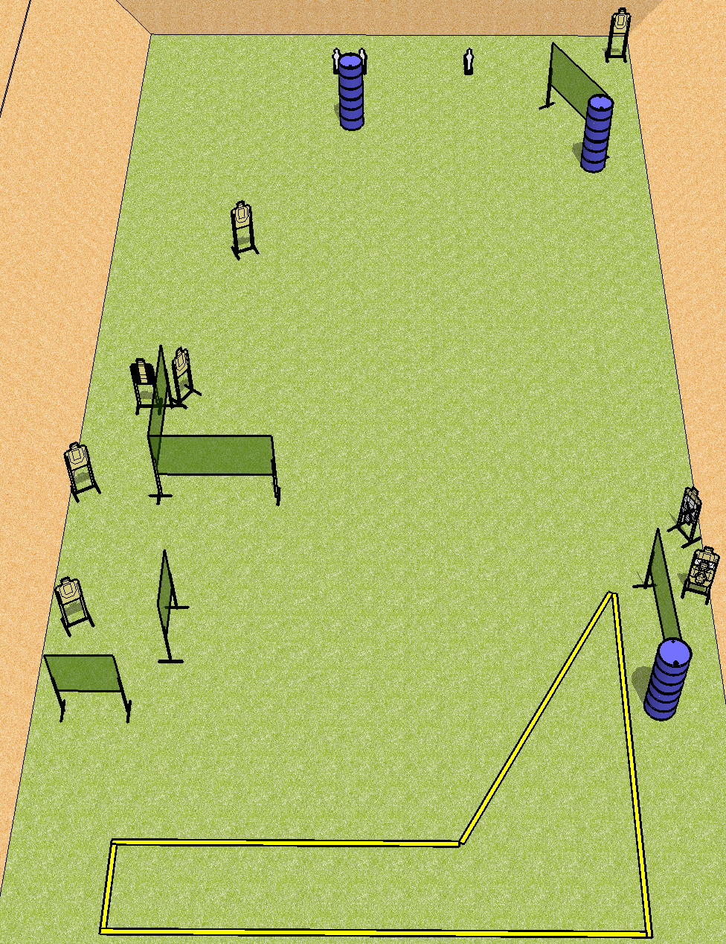
 | Dothan Practical Shooters – USPSA Match A Long Way Course Designer : Drew Coleman Bay: A1
Round Count 21 rounds 9 USPSA 3 mini poppers
Equipment List 11 wall feet Back fault line is 30’ wide 1 tux 10 targets (8 + 2NS)

Slide 2
A Long Way
Written Stage Briefing
Scoring: Comstock Rounds: 21
Targets: 9 USPSA, 3 steel
Handgun start position: anywhere inside the shooting area, wrists below belt. Handgun is loaded and holstered.
PCC start position: anywhere inside the shooting area, stock on belt. Loaded carbine is held with both hands, safety on.
Stage Procedure: on the audible start signal, engage targets as they become available from within the shooting area.

